Slide 1
Frequency-Domain Analysis of Control Systems
chapter 4

Slide 2
Review
Nyquist criterion( continued)
Definition of Bode plot
Bode plots of typical transfer functions
How to compose the Bode plot of a system
Minimum-phase system
Relative stability: gain margin and phase margin
Gain and phase margin on Bode plot
Calculation of stability margin according to Bode plot

Slide 3
Outlines
Calculation of stability margin according to Bode plot
Bode plots of minimum-phase systems
Performance criteria in frequency domain

Slide 4
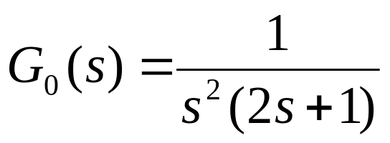











Calculation of Stability Margins
Example 4.13 Find the phase margin of the system with the following
open-loop transfer function, and estimate the system stability.
Q:
Two function blocks
0
40
-90
20
-180
-270

Slide 5
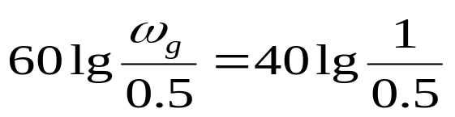

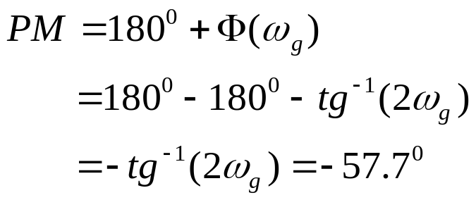
Calculation of Stability Margins
40
-40
20
-60
0dB
0.5
1
0
-90
-180
-270
system is unstable

Slide 6
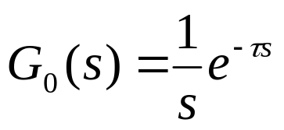


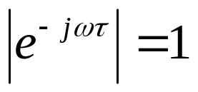
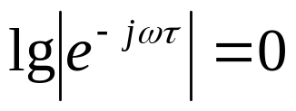




Calculation of Stability Margins
Example 4.14 Find the phase margin of the system with the following
open-loop transfer function, and estimate the system stability.
A:
Two function blocks
20
0
-90
-180

Slide 7
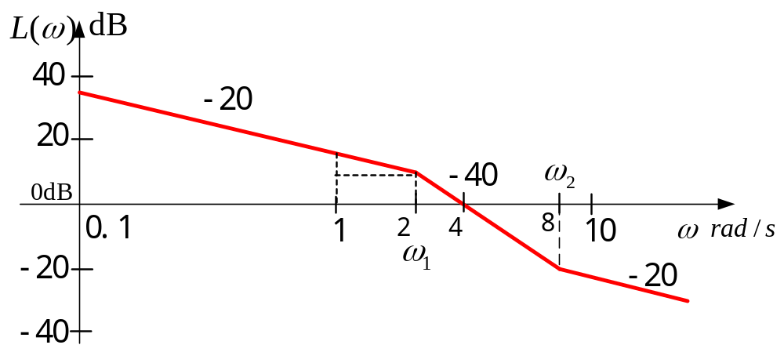
Bode Plot of Minimum-phase Systems
If a system is of a minimum-phase type, its open-loop transfer function can be
uniquely determined by its open-loop Bode plot.
Example 4.15 please construct the open-loop transfer function according to
the given open-loop Bode plot.

Slide 8




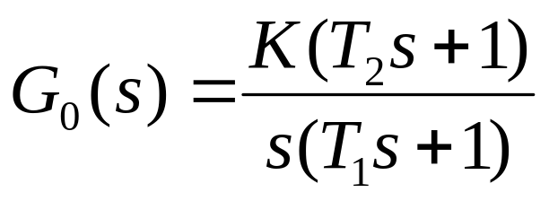
Bode Plot of Minimum-phase Systems
A: low-frequency section has a -20dB
per decade slope, there must exists an
integration block.
In the intermediate-frequency range, the
slope decreases by -20dB, there should be
an inertial block.
In the high-frequency range, the slope
increases by 20dB, it means that a
proportional and derivative block takes
effects.
40
20
-20
-40
So, the open-loop TF should has a form like:

Slide 9
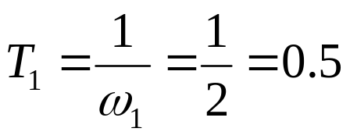



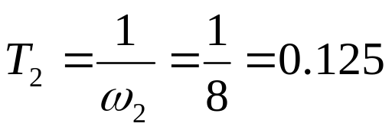

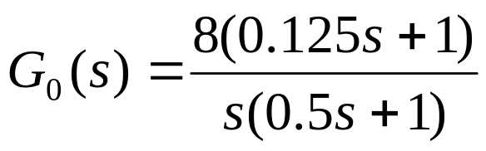
Bode Plot of Minimum-phase Systems
40
20
-20
-40
Determine the open-loop gain K:

Slide 10
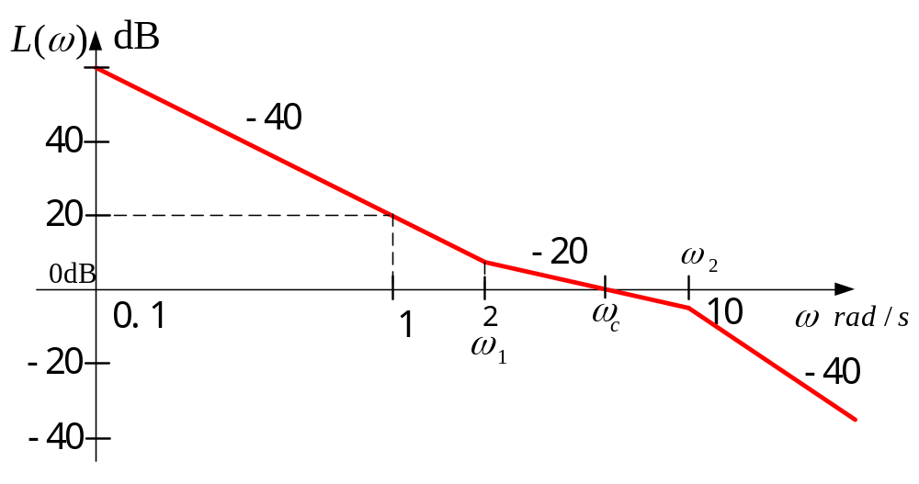
Bode Plot of Minimum-phase Systems
Example 4.16 please construct the open-loop transfer function according to
the given open-loop Bode plot.

Slide 11
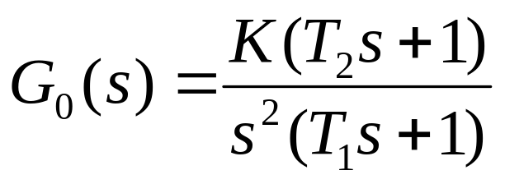
Bode Plot of Minimum-phase Systems
A: low-frequency section has a -40dB
per decade slope, there must exists a 2nd
integration block.
In the intermediate-frequency range, the
slope increases by 20dB, there should be
proportional and derivative block.
In the high-frequency range, the slope
decreases by 20dB, it means that an
inertial block takes effects.
60
40
20
-20
-40
So, the open-loop TF should has a form like:

Slide 12
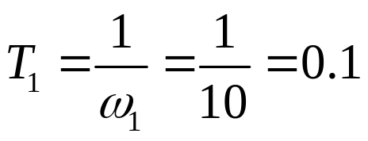
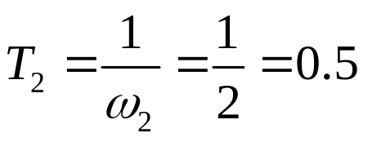




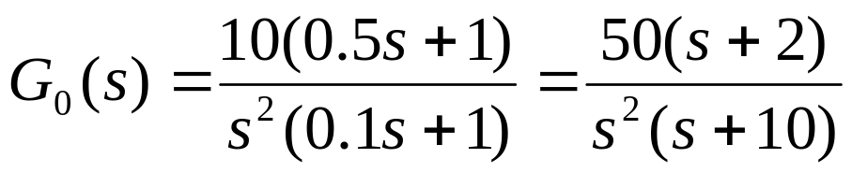
Bode Plot of Minimum-phase Systems
60
40
20
-20
-40

Slide 13
Bode Plot of Minimum-phase Systems
If a system is of minimum-phase type, its magnitude plot and phase plot are
uniquely related. The phase in a certain frequency range is determined by the
slope of the line in the magnitude plot in the same frequency range, as well as
the slope of neighboring lines. The shorter the frequency range is, the greater
impacts the neighboring slopes have
40
-20
20
-40
ω
0dB
2
0.1
1
2
4
8
10
ω
ω
-20
1
-20
-40
ω
ω
1
2
0
0
0.1
1
2
4
8
10
ω
­
90
0
Asymptote
-180
0

Slide 14
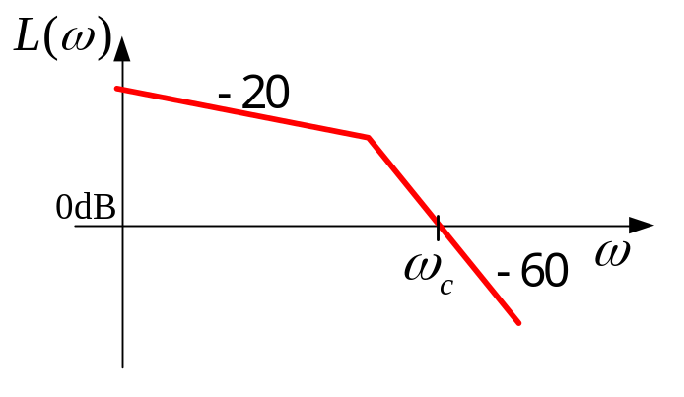
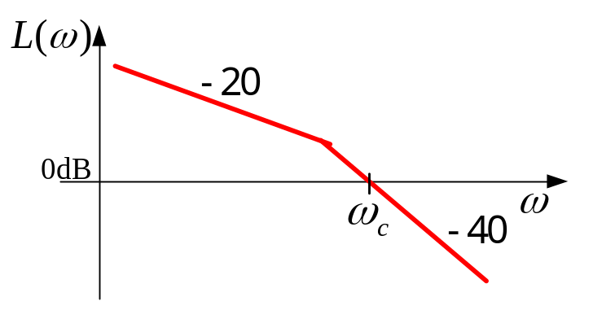
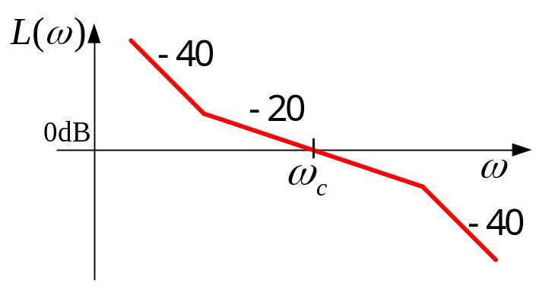
Bode Plot of Minimum-phase Systems
The slope of the line that passes through the 0dB line (real axis) determines the performance (stability) of the system. In order to keep the system stable
and ensure enough stability margins, the line that passes through the real axis should have a slope of -20dB/decade. The gain crossover frequency should keep enough distance from the neighboring lines with other slopes (usually about 1 decade). Why are the neighbors all bad guys?
Unstable
Possibly stable
Stable and with enough margin

Slide 15
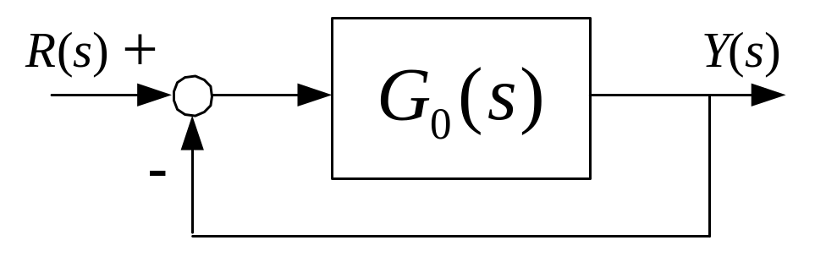
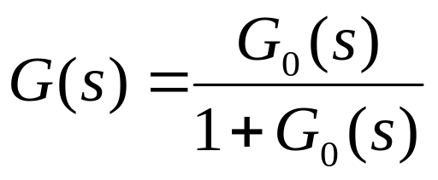
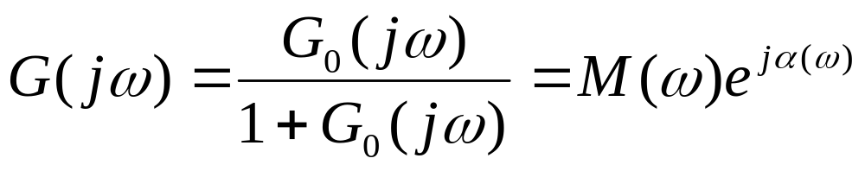
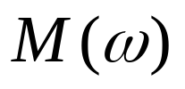
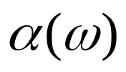
Performance criteria in frequency domain
the magnitude-frequency characteristics
the phase-frequency characteristics

Slide 16
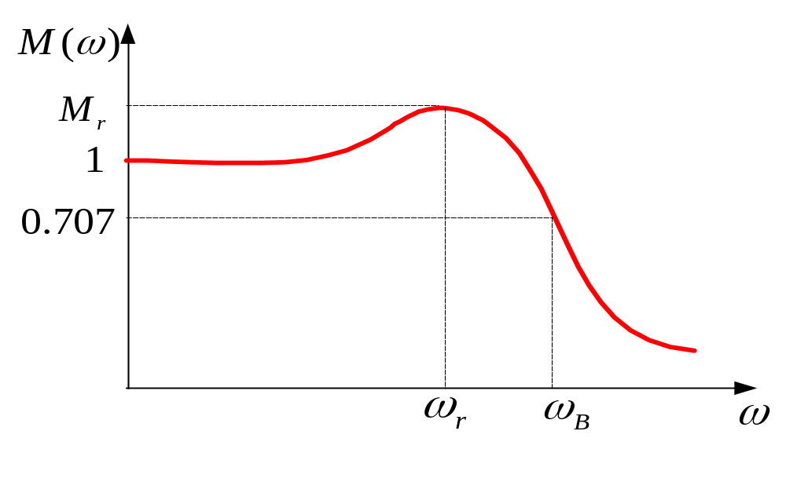


Performance criteria in frequency domain
Cutoff Rate
Resonant Peak :
is the maximum value of
Resonant Frequency :
is the frequency at which the peak resonance
occurs.
Bandwidth BW: is the frequency at which drops to 70.7 percent of, or
3 dB down from its zero-frequency value.
Cutoff Rate: is the slope of at high frequency.

Slide 17
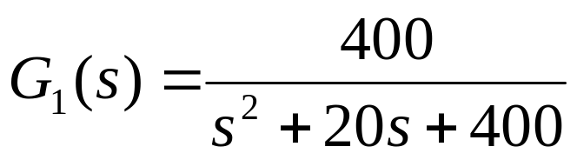
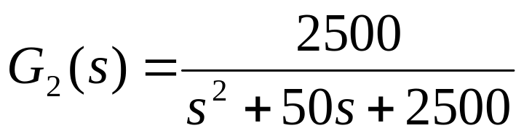
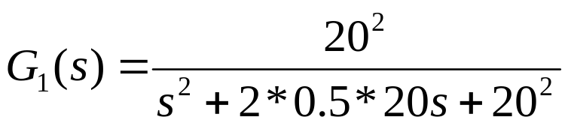

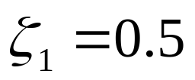
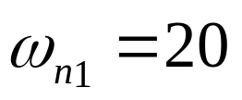

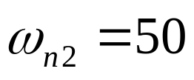
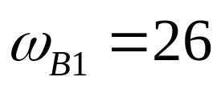
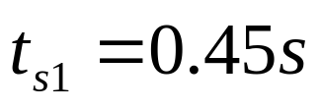
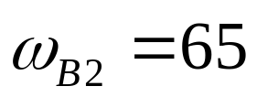
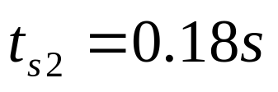
Performance criteria in frequency domain
How do frequency domain performance indices
relate to the indices in time domain?

Slide 18



Performance criteria in frequency domain
10
G
1
G
0
2
1.0
/dB
)
-3
s
(
G
lg
20
-10
-20
0.0
0
20
40
60
80
ω
rad/s
0
0.1
0.2
0.3
0.4
0.5
t
/ s

Slide 19
Performance criteria in frequency domain
The higher the gain crossover frequency of a open-loop system is, the higher the bandwidth of the closed-loop is. In general, the bandwidth of a control system gives an indication of the transient response properties in the time domain. A large bandwidth corresponds to a faster rise time and settling time, since the higher-frequency signals are more easily passed through the system.
Bandwidth also indicates the noise-filtering characteristics and the robustness of the system.

Slide 20

Performance criteria in frequency domain
In general, the magnitude of gives indication of the relative stability of a stable closed-loop system. Normally, a large corresponds to a large maximum overshot of the step response. For most control systems, it is generally accepted in practice that the desirable value of should be between 1.1 and 1.5.
There is no analytical expression to describe the relationship between time-domain performance indices and those in frequency-domain.

Slide 21
Control System Design
Chapter 5

Slide 22
Review of Last Chapter
Frequency response
Nyquist plot and Nyquist criterion
Bode plot
Minimum-phase systems
Stability margin of a system

Slide 23
Overview of This Chapter
Basics of designing a control system
Control system design using time-domain method
Control system design using frequency-domain method

Slide 24
Outlines of Today’s Lesson
Three steps involved in control system design
Commonly used specifications
Controller configuration
Typical Controllers
Control system design using time-domain method

Slide 25
Introduction to Control System Design
Three steps involved in control system design
  Determine what the system should do and how to do it (design specifications).
  Determine the controller or compensator configuration relative to how it is connected to the controlled process.
  Determine the type and parameter values of the controller to achieve the design goals.

Slide 26
Design Specification
Commonly used specifications
  Stability, steady-state accuracy (error), transient-response, frequency-response characteristics
  Time-domain: maximum overshoot, rise time, settling time, etc
  Frequency-domain: resonant peak, bandwidth, gain margin, phase margin, etc.

Slide 27
Design in Frequency- or Time- domain
About the design tools
  Historically, the design of linear control systems was developed with a wealth of graphical tools in frequency domain. The advantages of these tools is that they can be sketched by following approximation methods without detailed plotting. High-order systems generally do not pose any particular problem
  Design in the time domain using such performance specifications as rise time, delay time, and so on, is feasible analytically only for second-order systems, or systems that can be approximated by second-order systems.
  Computers rapidly change the practice of control system design.

Slide 28



Controller Configuration
Controlled
Process
Control
vector
Controlled
variables
output vector
Control objective is to have the controlled variables behave in certain desirable ways. The problem essentially involves the determination of the control signal
over the prescribed time interval so that the design objectives are all satisfied.
Most of the conventional design methods in control systems rely on the fixed-configuration design, in which at the outset the designer decides the basic configuration of the overall designed system and the place where the controller is to be positioned relative to the controlled process.
The problem then involves the design of the elements of the controller. And most control efforts involve the modification or compensation of the system-performance characteristics.

Slide 29





Controller Configuration
Controller
Controlled
Process
+
-
Series (cascade) compensation
Controlled
Process
+
-
Controller
feedback compensation

Slide 30





Controller Configuration
Controller
Controlled
Process
+
-
Controller
Series-feedback compensation
Controlled
Process
+
-
state feedback compensation

Slide 31
Controller Configuration
Controller
Controller
Controlled
Process
+
-
feedforward compensation with series compensation
Controller
+
Controller
Controlled
Process
+
+
-
feedforward compensation

Slide 32
Fundamental Principles of Design
After a controller configuration is chosen, the designer must choose a controller type with proper selection of its element values. Engineering practice dictates that one chooses the simplest controller that meets all the design specifications.
After a controller is chosen, the next task is to choose controller parameter values. These parameter values are typically the coefficients of one or more transfer functions making up the controller.

Slide 33
Fundamental Principles of Design
The time-domain design usually relies heavily on the s-plane and the root loci. Frequency-domain design is based on manipulating the gain and phase of the open-loop transfer function so that the specifications are met.
Time- and frequency domain characteristics can be used as guidelines for design purposes.

Slide 34
Guidelines for Design
Complex-conjugate poles of the closed-loop transfer function lead to a step response that is underdamped.
If all system poles are real, the step response is overdamped.
Zeros of the closed-loop transfer function may cause overshoot even if the system is overdamped.
The response of a system is dominated by those poles closest to the origin in the s-plane. Transients due to those poles farther to the left decay faster.

Slide 35
Guidelines for Design
The farther to the left in the s-plane the system’s dominant poles are, the faster the system will respond and the greater its bandwidth will be.
When a pole and zero of a system transfer function nearly cancel each other, the portion of the system response associated with the pole will have a small magnitude.
Time- and frequency-domain specifications are loosely associated with each other. Rise time and bandwidth are inversely proportional. Resonant peak and damping are inversely proportional. Phase margin, gain margin and damping are proportional.

Slide 36
Guidelines for Design
The farther to the left in the s-plane the system’s dominant poles are, the more expensive it will be and the larger its internal signals will be. Although this can be justified analytically, it is obvious that striking a nail harder with a hammer drives the nail in faster but request more energy per strike. Similarly, a sports car can accelerate faster, but it uses more fuel than an average car.

Slide 37
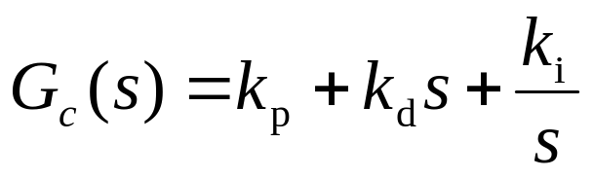
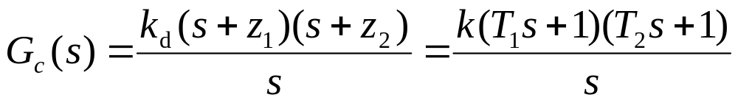
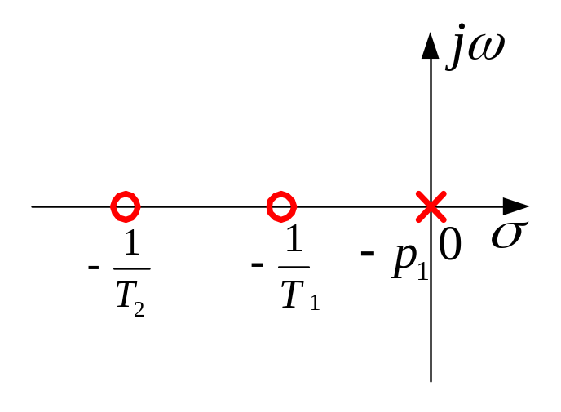


Typical Controllers
PID (Proportional, Integral, Derivative) controller
dB
-20
+20
0dB
1
1
ω
rad/s
T
T
1
2

Slide 38
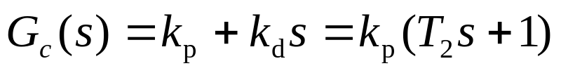
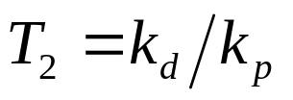

Typical Controllers
PD (Proportional, Derivative) controller
dB
j
ω
+20
0dB
0
σ
1
ω
−
1
rad/s
T
T
2
2

Slide 39
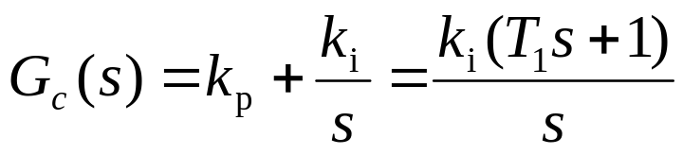
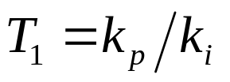

Typical Controllers
PI (Proportional, Integral) controller
ω
dB
j
-20
0dB
1
0
σ
1
ω
−
−
p
rad/s
T
1
T
1
1

Slide 40
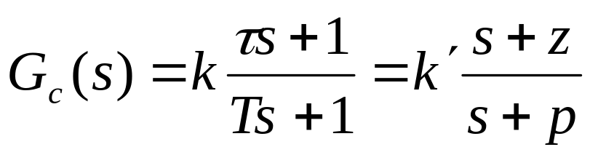
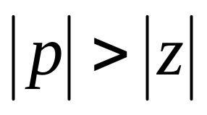
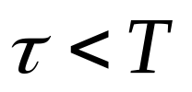
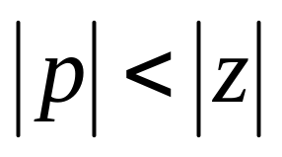
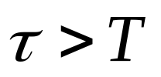
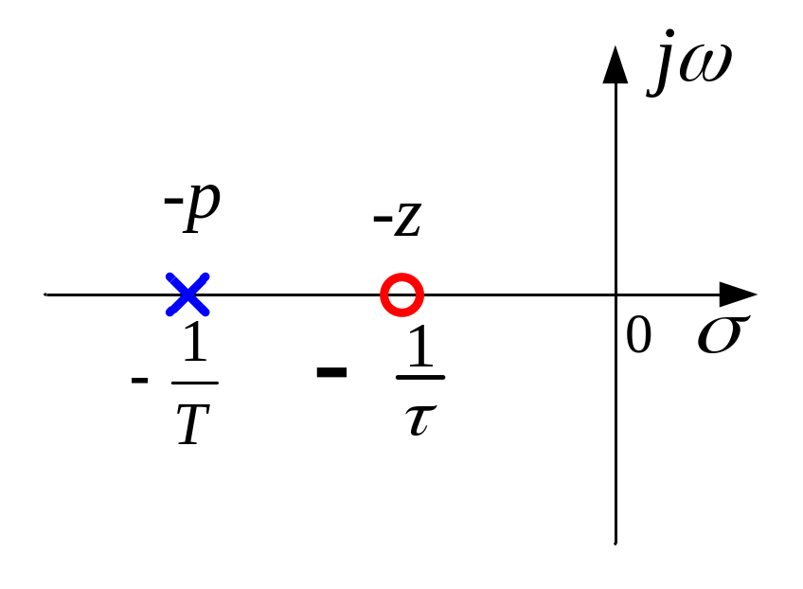
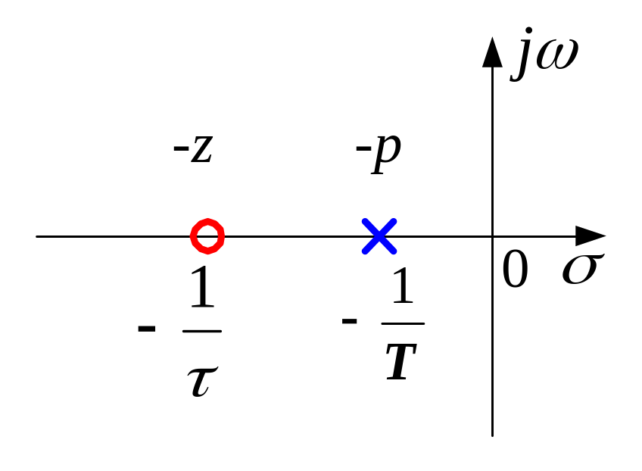
Typical Controllers
Phase- Lead or lag controller
Lead
Lag

Slide 41
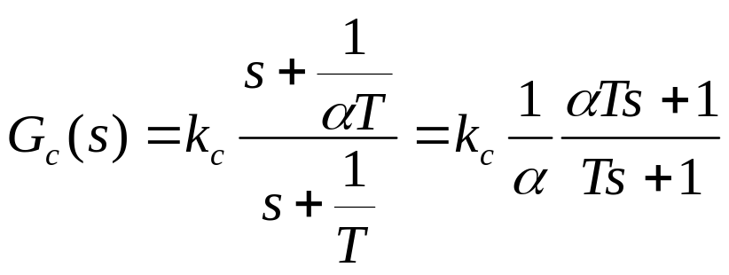





Phase-Lead Controllers

Slide 42







Phase-Lead Controllers
Maximum phase lead occurs at
Maximum phase lead is

Slide 43





Phase-Lead Controllers
Physical implementation

Slide 44






Phase-Lag Controllers
L
ω
( )
1
0dB
T
α
-20
ω
20lg
1
α
T
Φ ω
( )
ω
0
0
m
ω

Slide 45






Phase-Lag Controllers
Physical implementation
L
ω
( )
0dB
ω
20lg
α
-20

Slide 46






Lead-Lag Controllers
Lead
Lag

Slide 47






Lead-Lag Controllers
Physical implementation

Slide 48



Some Comparison
dB
PI controller
Phase-lag controller
-20
k
p
0dB
1
ω
1
rad/s
T
T
1

Slide 49


Some Comparison
PD controller
dB
Phase-lead controller
+20
k
p
0dB
1
1
ω
rad/s
T
T
2

Slide 50





Controller Design with Time-Domain Methods
Expected time-domain performance indices and desirable poles
Desirable
Dominant
Pole
overshoot
Overshoot
-
p
1
Feasible
Region
Settling time
σ
Desirable
Dominant
Pole
overshoot
-
p
2
Settling time

Slide 51










Example – 5.1
Q: the open-loop transfer function of a unit feedback system is shown
as follows. Please design a controller so that the following performance
specifications are satisfied: , ,
A:
1st step: check the performance specifications of the original system
(1) the steady-state error
The original system is a type 1 system,
(2) the dynamic performance indices

Slide 52




2nd step: sketch the root loci of the original system
j
ω
j
3
poles of the original
closed-loop system
poles of the open-loop TF
-
p
-
p
2
1
σ
-4
-3
-2
-1
0
Coordinates of the poles of
the original closed-loop system
−
j
3

Slide 53






3rd step: calculate the coordinates of the desirable poles of the compensated system
j
ω
desirable
dominant
poles
when
and
σ
desirable system
-3
-2
-1
0

Slide 54





One method for designing the controller
cancellation method

Slide 55



4th step: determine system configuration and the controller type
Choose the series compensation.
Because the modified system has poles more left to the
axis than the original system, its time response to the unit-
step signal will be faster than that of the original system.
A phase-lead block can increase the system gain in the high-frequency band, therefore fasten the system response. So, a
phase-lead block is chosen to be the controller.
where

Slide 56
5th step: determine the parameter value of the controller
desired dominant pole
ω
j
Undesired
dominant pole
-
p
-
p
-
z
-
p
c
2
c
1
σ
-4
-2
0
The dominant pole is too
close to the imaginary axis!
desired dominant pole

Slide 57
Desired position of the controller’s zero and pole.
desired dominant pole
j
ω
-
p
-
z
-
p
-
p
c
c
2
1
σ
-4
-2
0
desired non-
dominant pole

Slide 58

desired dominant pole
j
ω
s
j
2
3
1
Three parameters need
to be determined.
θ
ϕ
ϕ
ϕ
c
2
1
c
The desirable poles can
afford two conditions
(equations).
-
p
σ
-4
-3
-2
0
c
-
z
-
p
-
p
desired non-
dominant pole
c
2
1
Have to add another
condition.
s
2
Set
desired dominant pole

Slide 59





desired dominant pole
ω
the modified open-loop
transfer function is:
j
s
j
2
3
1
θ
ϕ
ϕ
ϕ
angle condition:
c
2
1
c
-
p
σ
-4
-3
-2
0
c
-
z
-
p
-
p
desired non-
dominant pole
c
2
1
s
2
desired dominant pole

Slide 60




magnitude condition:

Slide 61







j
ω
zero of open-loop TF
-3.6
-5.6
-3
-2
σ
0
non-dominant pole of closed-loop TF
dominant pole of closed-loop TF

Slide 62
Matlab Verification
m2=(4*(s+2)/(s+4))*k/(s*(s+2));
sys2=feedback(m2,1);
step(sys2,’r’)
s=tf('s');
k=4;
m0=k/(s*(s+2));
sys=feedback(m0,1);
step(sys,’b’)
hold on
grid on
Method 1 (Cancellation)
m1=(5*(s+3)/(s+5.5))*k/(s*(s+2));
sys1=feedback(m1,1);
step(sys1,’g’)
Method 2 (Phase-lead)

Slide 63

Matlab Verification

Slide 64






Example - 5.2
Q: the open-loop transfer function of a unit feedback system is shown as follows. Please design a controller so that the following performance specifications are satisfied: the maximum overshoot , steady-state error to unit-ramp signal
A:
1st step: check the performance specifications of the original system
The system is a type 1 system, the steady-state error of the system
to unit-ramp signal is:
where

Slide 65










The characteristic equation is:
The system is unstable. In another word, there does not exist a stable system that satisfies the performance specification.

Slide 66





2nd step: sketch the root loci of the original system
poles of the open-loop transfer function:
j
ω
the intersect of the asymptotes:
σ
-5
-2
-1
0
angles of asymptotic lines

Slide 67






3rd step: calculate the coordinates of the poles on the root loci according to the given performance specifications.
j
ω
Guess a coordinate along the dashed line
j0.8
σ
-5
-2
-1
-0.4
0

Slide 68



guessed
pole
j
0.8
9.8
0
53
0
63
0
117
0
-5
-1
−
0.4
0
Verify the angle condition
Settling time
Verify the steady-state error.
According to magnitude condition

Slide 69



Does not satisfy the given performance specification. Need compensation.
Phase-lag controller can increase the steady-state accuracy. So, a phase-
lag controller is chosen.
The distance of the zero of the phase-lag controller to the imaginary axis
should be 1/5 ~ 1/10 of that of the dominant pole to the imaginary axis.

Slide 70






0
The real coordinate of the dominant pole is -0.4, the zero of the controller should be -0.4/5=-0.08.
The steady-state accuracy should be increased by 10 times also, so the coordinate of the pole of the controller should be -0.008.

Slide 71




The open-loop TF of the compensated system:

Slide 72
Matlab verification
s=tf('s');
k=4.2;
m=k/(s*(s+1)*(s+5));
sys=feedback(m,1);
step(sys,’r’);
hold on;
grid on;
m1=((s+0.08)/(s+0.008))*k/(s*(s+1)*(s+5));
sys1=feedback(m1,1);
step(sys1,’b’);
s=tf('s');
k=4.2;
m=k/(s*(s+1)*(s+5));
sys=feedback(m,1);
t=0:0.1:20;
lsim(sys,t,t);
grid on;
hold on;
m1=((s+0.08)/(s+0.008))*k/(s*(s+1)*(s+5));
sys1=feedback(m1,1);
lsim(sys1,t,t);

Slide 73

Unit - Step Response

Slide 74

Unit - Ramp Response

Slide 75
Remarks
Experiences are extremely useful for controller design.
Trial-and-error is necessary for both experts and novices.

Slide 76
Wrap-up
Three steps involved in control system design
Commonly used specifications
Controller configuration
Typical Controllers
Control system design using time-domain method

Slide 77

Assignment
Page 106
  8 (4)
  9
  10 (a) (d)

